Slide 1

Notes:
Welcome and introductions.
It's great to be here to share about United Way of Lake County, how we're leading transformational change here in our local community, and how you can get involved and be our next Community Hero.
Let's start by highlighting our Lake County community.

Slide 2
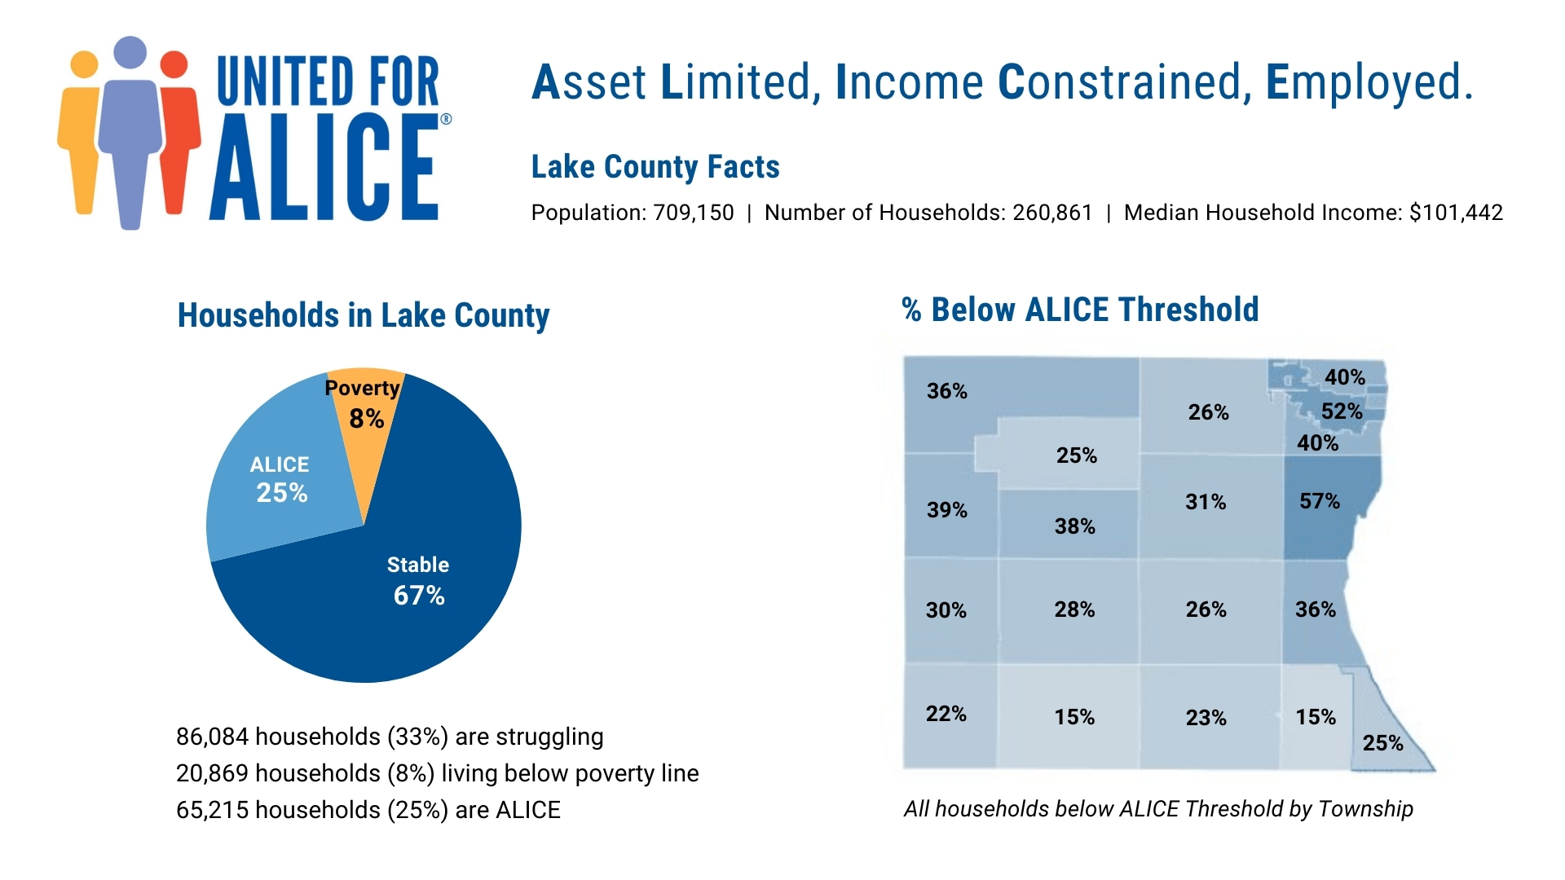
Notes:
United Way has an innovative research project call ALICE that provides financial insights into the struggles many working families and individuals face across the nation, in Illinois and right here in Lake County.
ALICE stands for “Asset Limited, Income Constrained, Employed”.
These are our family members, friends and neighbors. ALICE households represent cashiers, waiters, childcare providers, and other members of our essential workforce who earn just above the Federal Poverty Level but less than what it costs to make ends meet. These struggling households are forced to make impossible choices every day.
What does it cost to afford the basic necessities in Lake County?
You might be surprised to learn that based on the Household Survival Budget, it takes $78,564 for a family of two adults and two children to afford just the basics, more than double the U.S. poverty level of $27,750 for a family of four.
The Household Survival Budget for a single adult is $35,928, compared to the U.S. poverty level of $13,590.
The research shows that in Lake County, a staggering 86,084 households (or 33%) are struggling, with 20,869 households (8%) living below the U.S poverty line and 65,215 (25%) falling into the ALICE population.
Looking at the map of Lake County, you'll see for some townships the percentage of households struggling is even higher, with Zion township at 52% and Waukegan at 57%.

Slide 3
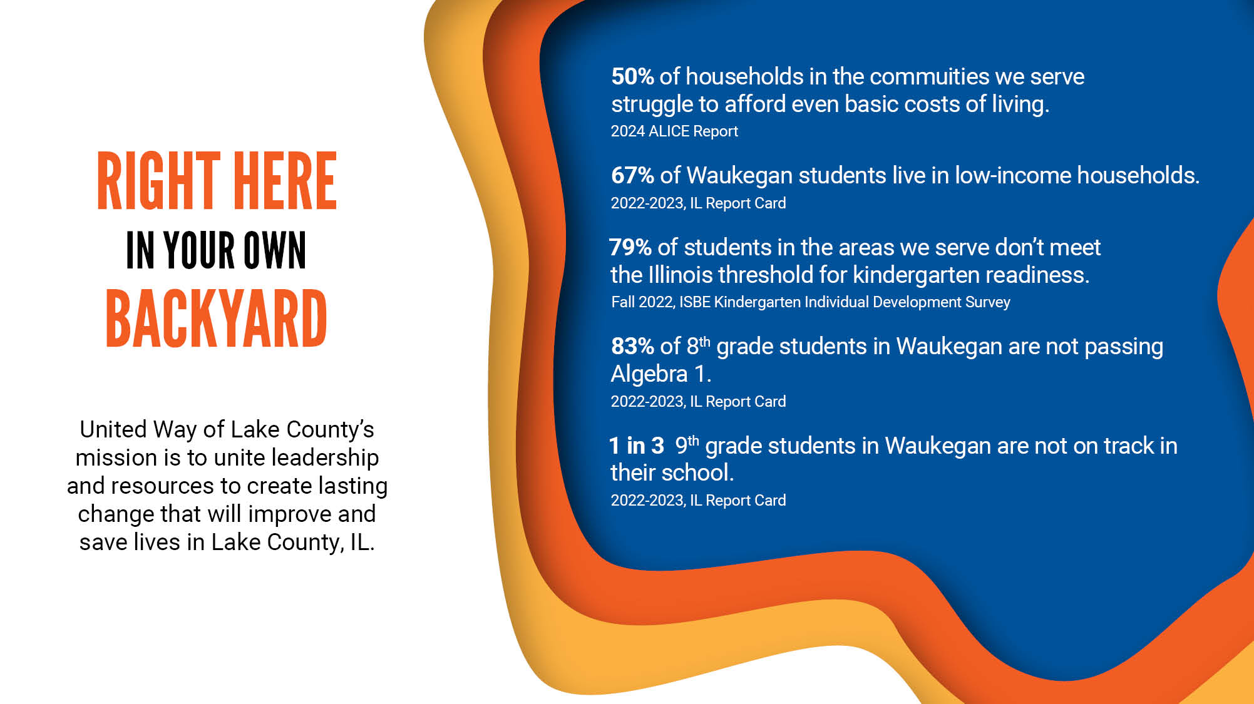
Notes:
United Way of Lake County's mission is to unite leadership and resources to create lasting change that will improve and save lives...and your support can make an impact right here in your own backyard!
Let's look at some more data about our local community, starting with the ALICE research we just touched on.
Did you know...
50% of households in the key communities we serve (Antioch, Fox Lake, North Chicago, Round Lake, Waukegan and Zion) can't afford even the basic costs of living. This includes costs for everyday essentials like housing, food, transportation, childcare, healthcare, technology (basic home internet and smartphone) and taxes.
67% of Waukegan students live in low-income households. Students ages 3 to 17 meet the low-income criteria if they receive or live in households that receive public aid from SNAP (Supplemental Nutrition Assistance Program) or TANF (Targeted Assistance for Needy Families); are classified as homeless, migrant, runaway, Head Start, or foster children; or live in a household where the household income meets (USDA) guidelines to receive free or reduced-price meals.
79% of students in the areas we serve are not ready for kindergarten. That means only 21% of students are ready for school in key developmental areas, including social and emotional development, language and literacy, and math, according to the most recent Illinois State Board of Education assessment. The 79% figure is an average. In Waukegan, 83% of students are not kindergarten ready and in North Chicago, 90%.
83% of 8th grade students in Waukegan are not passing Algebra 1. Algebra 1 is described as a gateway course because students typically need to pass Algebra 1 before moving on to high-level math and science courses. Students who pass Algebra 1 in 8th grade will likely have the opportunity to take Calculus before they graduate – a prerequisite for college STEM majors and careers.
1 in 3 9th grade students in Waukegan are not on track in their school. Freshmen on track is a key predictor of high school success. Students who finish the ninth-grade year on track are almost four times as likely to graduate from high school as students who are not on track. A high school diploma is vital for students who plan to enter college and for their future success, including paving the way for more career opportunities and better-paying jobs. High school dropouts on the other hand are more likely to be unemployed, be welfare recipients, when employed earn less money, lack health insurance and suffer poor health.

Slide 4

Notes:
Watch this engaging video to see how United Way of Lake County is addressing these challenges and leading the way to a better future for all.

Slide 5
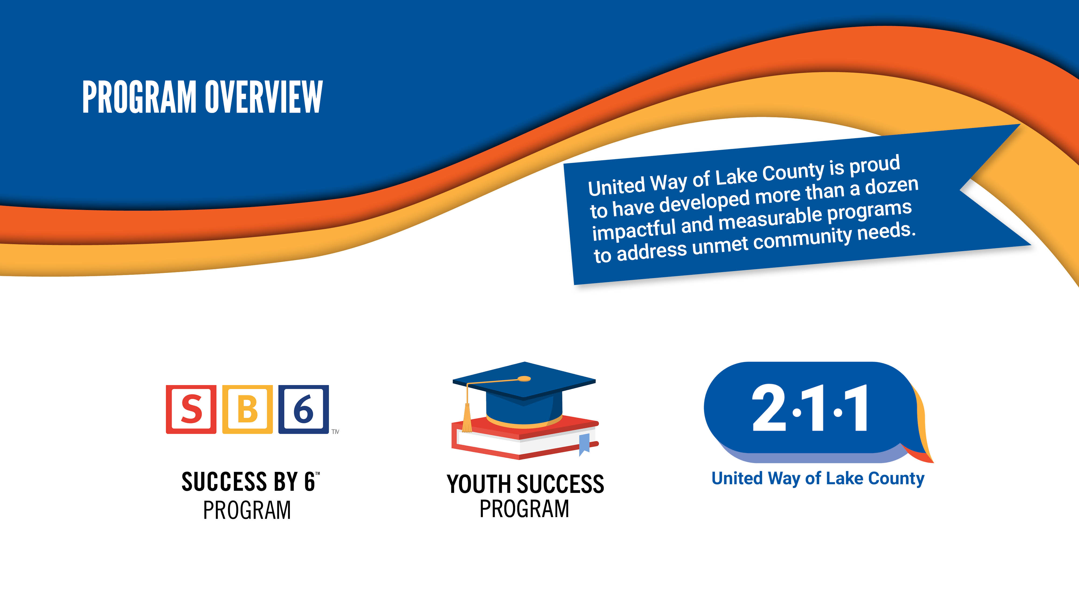
Notes:
United Way of Lake County is proud to have developed more than a dozen impactful and measurable programs to address unmet community needs.
We are equipping local children, youth, and families with tools to build a path to education and lifelong success.
We believe the most valuable investment we can make is in our children’s education.
Our education programs promote healthy early childhood development to ensure all children enter school ready to succeed, and help youth succeed in school and beyond.
Our 211 helpline provides life-changing support for individuals and families in need by guiding them to vital information and resources. 211 is Lake County’s one-stop shop for help with health and human services!
Putting it all together, we are building an equitable future where all our Lake County children and families can thrive.

Slide 6
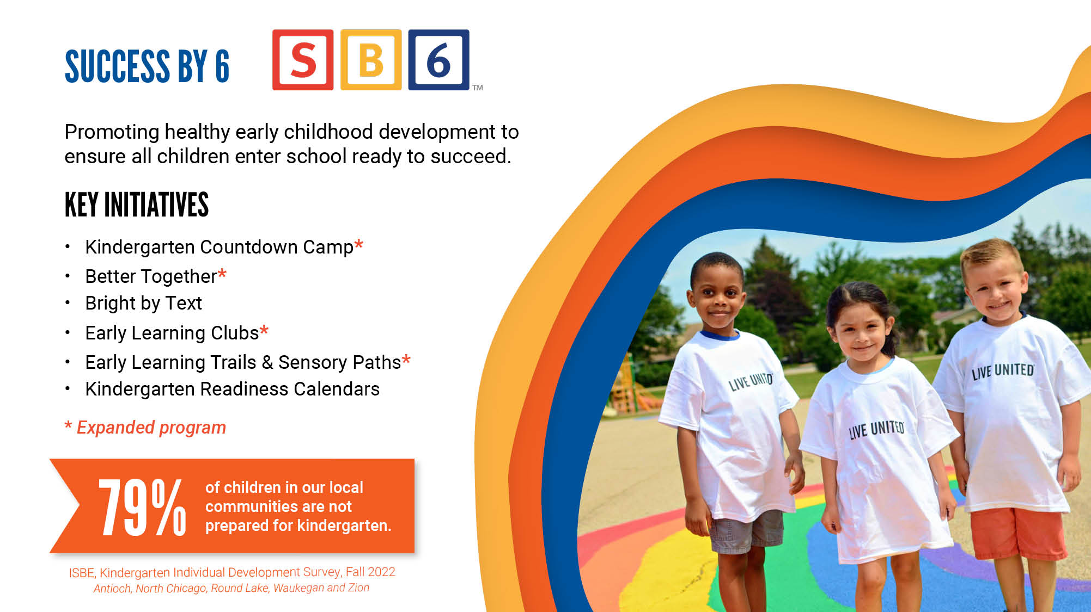
Notes:
Let's start by taking a look at our Success By 6 program — the research-backed concept that a strong academic career depends on the learning that happens before a child turns 6.
Reaching families when children are very young makes a real difference. There's solid evidence that the first six years are crucial in shaping a child's life.
Our core Success By 6 programs include:
Kindergarten Countdown Camp gives children who haven’t been to preschool the chance to learn skills they need to start strong…writing their names, learning their colors, following directions…all that good stuff that is so crucial before the academic learning can sink in.
Better Together and Early Learning Clubs are our research-based workshops for families with little kids. Parents discover how to truly be their child's first teacher through play, literacy, and hands-on activities. These are happening in our local communities with limited access to opportunities, including most recently at the Whispering Oaks low-income apartments right on the border of Waukegan and North Chicago in a program led by our own Women United.
Bright by Text is a newer program for Lake County families with young children. This cool and free texting service sends custom messages in English or Spanish to parents based on the ages of their kids. It gives them tips, games and resources so they can make the most of their everyday interactions… that “pre-work” leads to later academic success.
Every year our volunteers paint Early Learning Trails at schools and libraries and install colorful, engaging Sensory Paths at schools, both focused on helping children develop key kindergarten readiness skills.
We also create and distribute 20,000 copies of our Kindergarten Readiness Calendars for families with daily helpful tips and activities as they teach their children.
Based on the most recent ISBE data, the pandemic has no doubt had a devastating impact on learning. The data shows just how much our early education programs are needed. Success By 6 has consistently delivered measurable improvements in kindergarten readiness for the past 17 years. Now the goal is to build capacity and expand these programs to reach even more children and additional communities.
ADDITIONAL EDUCATION STAT:
Each dollar invested in high-quality early childhood programs and services from birth to age 5 has a 13% return annually. (Heckman)

Slide 7
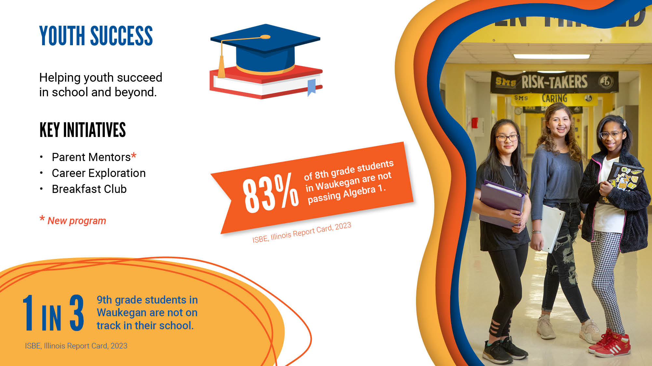
Notes:
Our Youth Success program helps students stay on track to graduation and provides them with critical support and resources they need to succeed in school, work and life.
The key initiatives are:
Parent Mentors: Parents are trained as classroom mentors and volunteer in a classroom four times a week for a minimum of 100 hours. They help students improve their math and literacy skills and provide social emotional support.
Career Exploration: Inspiring experiences for students that highlight the diversity of both the people and job opportunities in STEM.
Breakfast Club: A before-school mentorship program for middle schoolers, created and led by Leaders United. Mentors provide the students with academic support, important interactions to help build their confidence and self-esteem, and guidance on skills needed to be successful in high school and beyond.
ADDITIONAL STATS (US Bureau of Labor Statistics):
In 2022, the median income of a college graduate is $74,464 compared to $35,464 for someone with less than a high school diploma.
In 2022, those who didn’t graduate high school had the highest unemployment rate and were more than TWICE as likely to be unemployed as someone with a bachelor’s degree.

Slide 8
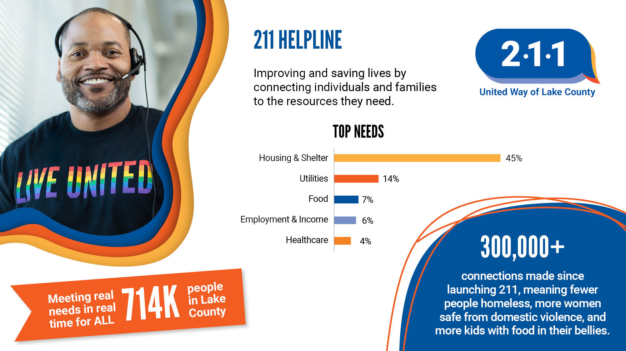
Notes:
United Way of Lake County's 211 helpline has truly been a lifeline in connecting individuals and families with critical resources to improve and save lives.
211 is an unmatched, critical service that was created for all members of our Lake County community. It's free, confidential, multilingual and helps people across the county find the resources they need, 24/7. From food assistance and help paying bills to health care answers and mental health resources to employment services and childcare, 211 guides people in their moments of need to local, available resources.
Since we launched the service in September 2019, 211 has made more than 300,000 connections to help...meaning fewer people homeless, more women safe from domestic violence, more kids with good in their bellies. Together, we have continued to raise awareness of 211 with expanded promotional materials, additional languages, exciting billboard and Pace bus campaigns, and a robust toolkit on our 211 website.
211 is a community-wide initiative with many partners and donors whose generous support helps us sustain this vital service available for all 714,000 Lake County residents.
Lake County is proud to lead the way to bring 211 services to all Illinois communities and serve as a model 211 program.
If you or someone you know needs help, call 211, text your zip code to 898-211, or visit 211LakeCounty.org.
ADDITIONAL STATS:
Feedback from community members is very positive. Of those contacts to 211 who received a follow-up call or text:
100% of contacts in crisis received the help they needed to deescalate their situation;
98% report staff are polite and professional, and
91% would recommend 211 to friends and family.

Slide 9
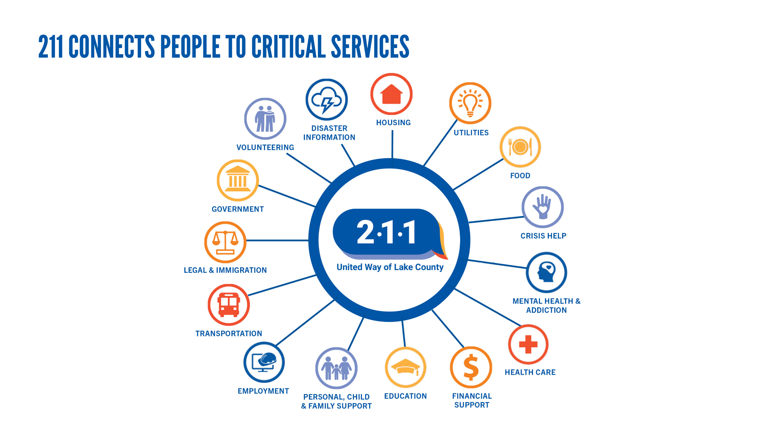
Notes:
Here's a closer look at the wide range of services and resources that 211 helps residents and providers navigate, regardless of the time of day, the language they speak or where they live. 211 is Lake County's one-stop shop for help!
In addition to helping people individually, 211 provides valuable data on top community needs for proactive planning and informed decision-making. This has been especially helpful in identifying the support our neighbors and families need most and where there are gaps in services. Our 211 team provides regular reporting on current needs and the populations were serve. There's also a data dashboard that provides a real-time snapshot of community-specific needs by zip code, legislative district or school district. Our 211 Advisory Council, which includes representatives from county and local government, social service agencies, healthcare providers, schools, corporate partners and other stakeholders, meets quarterly to review 211 results, trend information and identify solutions.
Undoubtedly, 211 is an unmatched, critical service and is here to help.

Slide 10
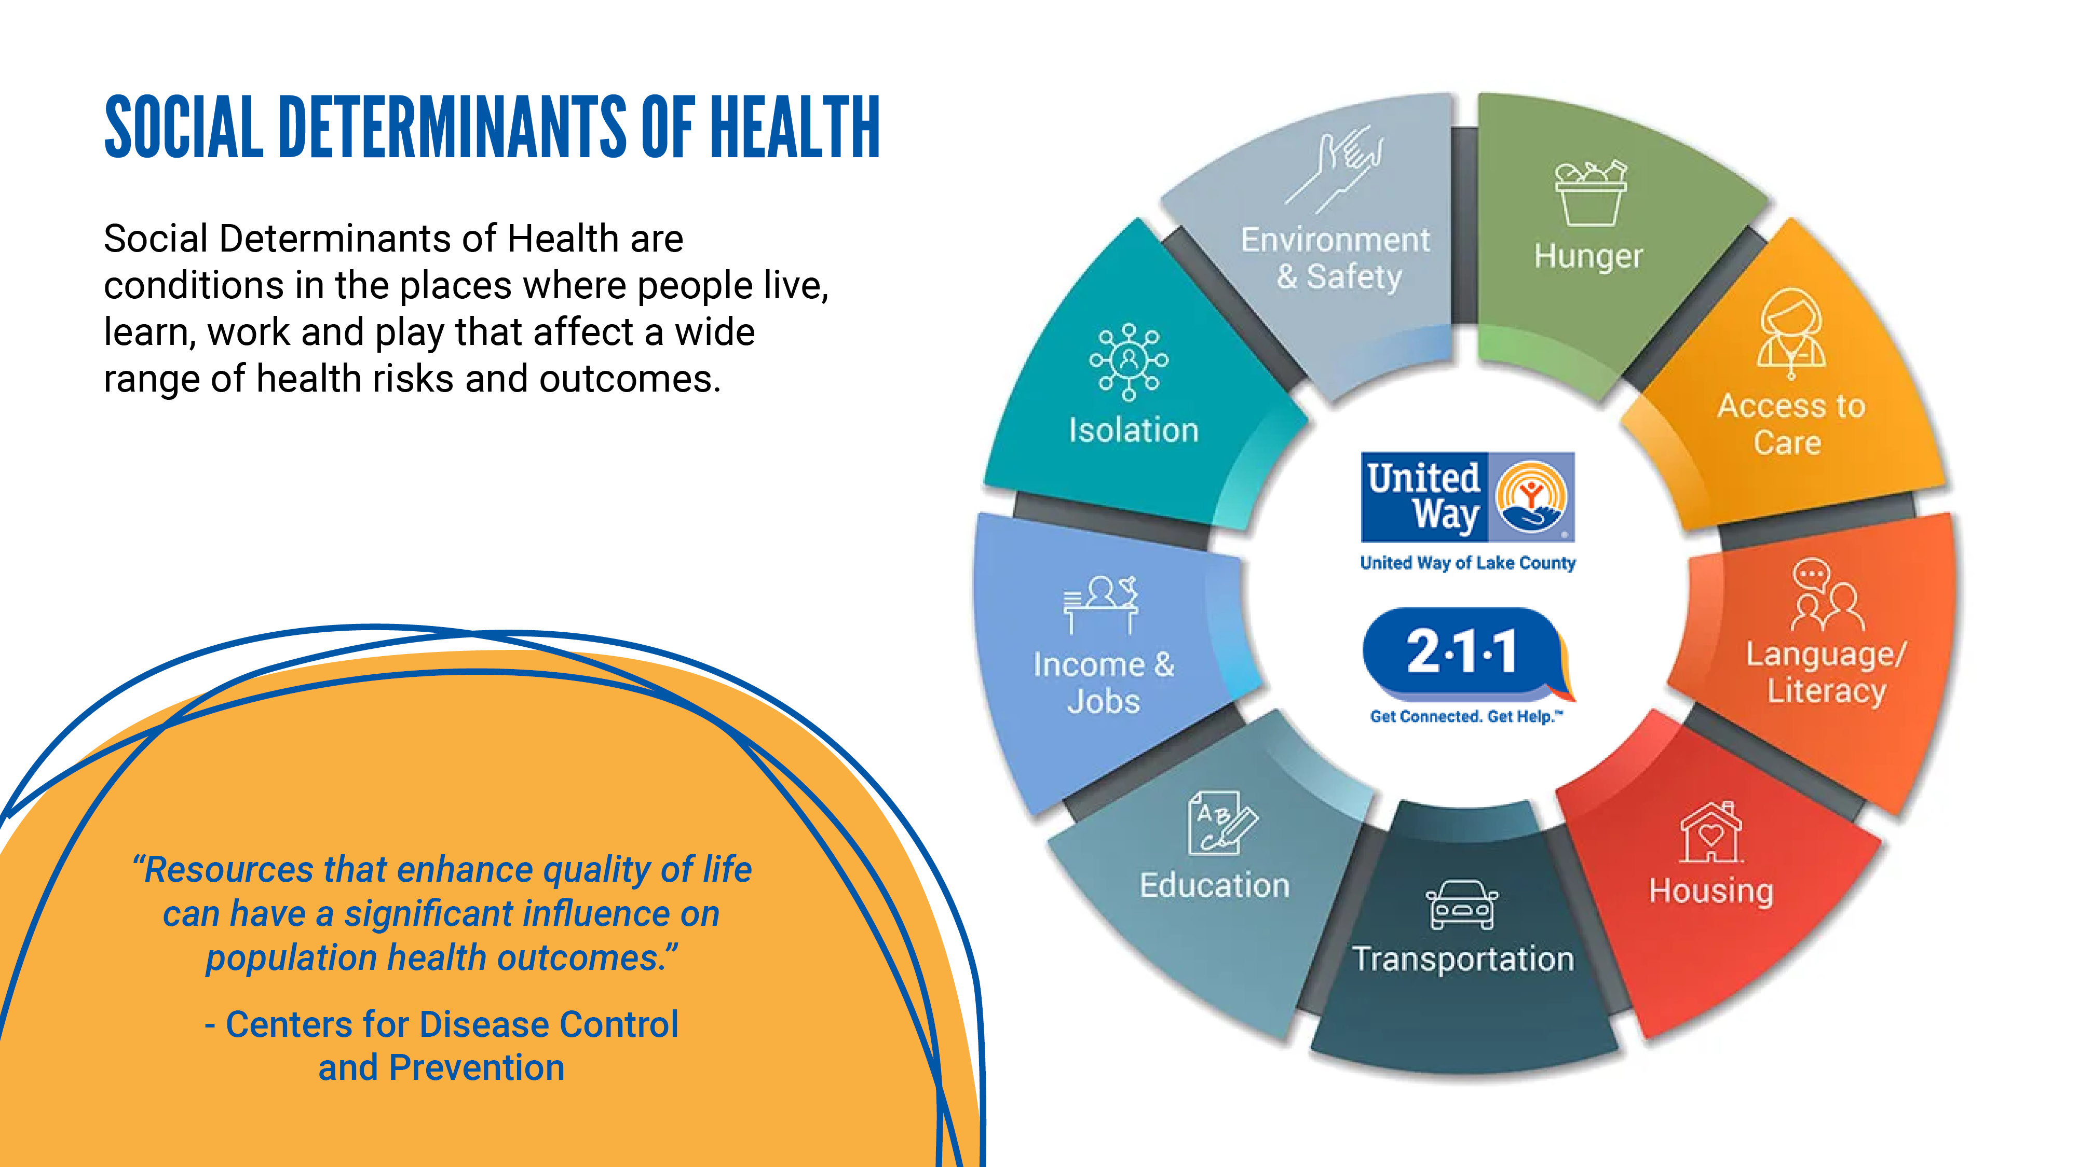
Notes:
You may have heard about Social Determinants of Health. These are the conditions in the places where we live, learn, work and play that affect a wide range of health risks and outcomes.
So, why is this important? Well, to build an inclusive and equitable community where everyone can thrive and achieve their human potential, we need to focus on ensuring that every person in our community is healthy.
Data shows us that there are many factors, outside traditional healthcare, that contribute to the overall health and well-being of a person, including:
Access to care
Access to quality education
Food security
Housing stability
Transportation
Where a person lives
For example, did you know that the mortality rate for those who live in zip code 60064 (North Chicago) is 14 years lower than those who live in the very next town, zip code 60045 (Lake Forest)?
Through 211, individuals and families can get connected to the help they need to address all the factors that impact their health, including fulfilling their basic needs, receiving quality education, and being on the path to financial success.
By streamlining access to critical health and human services for individuals and families, working with our communities to understand and address their needs, and redesigning systems, United Way of Lake County aims to improve outcomes for everyone in Lake County--regardless of race, ethnicity, income or zip code.
Additional Lake County data:
Live Well Lake County Community Health Assessment
https://www.lakecountyil.gov/DocumentCenter/View/14515/CHA-2016?bidId=

Slide 11
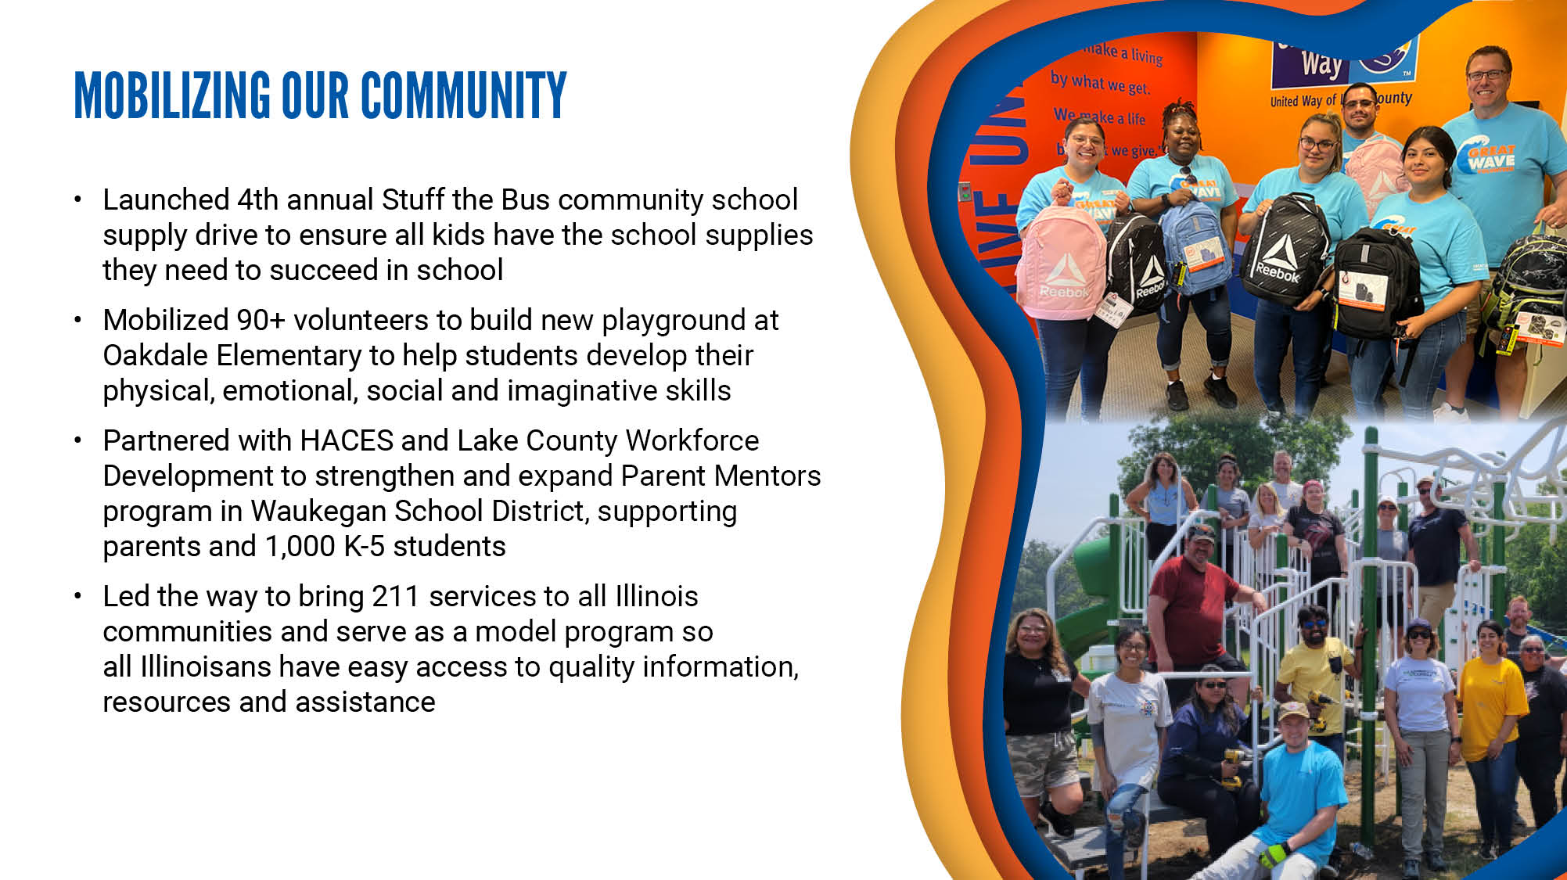
Notes:
We bring people together to build a stronger community where everyone can get a quality education, a good job and live a healthy life. But we don’t do it alone: United Way of Lake County unites people, organizations and communities in purpose. Together, we mobilize resources swiftly and purposefully to address needs and make life better for every person in our community.
Here are just a few examples:
We launched the fourth annual Stuff the Bus community school supply drive to ensure all kids have the school supplies they need—preparing them for their academic studies, building their self-esteem and setting them up for success. More than 3,000 students received backpacks filled with supplies last year.
We mobilized more than 90 volunteers to build a new playground at Oakdale Elementary School in Waukegan to help students develop their physical, emotional, social and imaginative skills necessary to gain self-confidence, improve coordination and advance critical thinking capabilities.
Partnered with HACES (Hispanic American Community Education Services) and Lake County Workforce Development to strengthen and expand Parent Mentor program in the Waukegan School District. The program supports more than 1,000 K-5 students while providing training and professional development opportunities for parents. Piloted paid internships for parents to work in the school district.
We led the way to bring 211 services to all Illinois communities and serve as a model program so that all Illinoisans have easy access to quality information, resources and assistance. We expanded 211 coverage from 36% one year ago to more than 90%, with 7 million more Illinoisans having access to 211.
Through United Way, your neighbors are making meaningful change, whether by charitable giving, volunteering or speaking out for policies that improve our community.

Slide 12
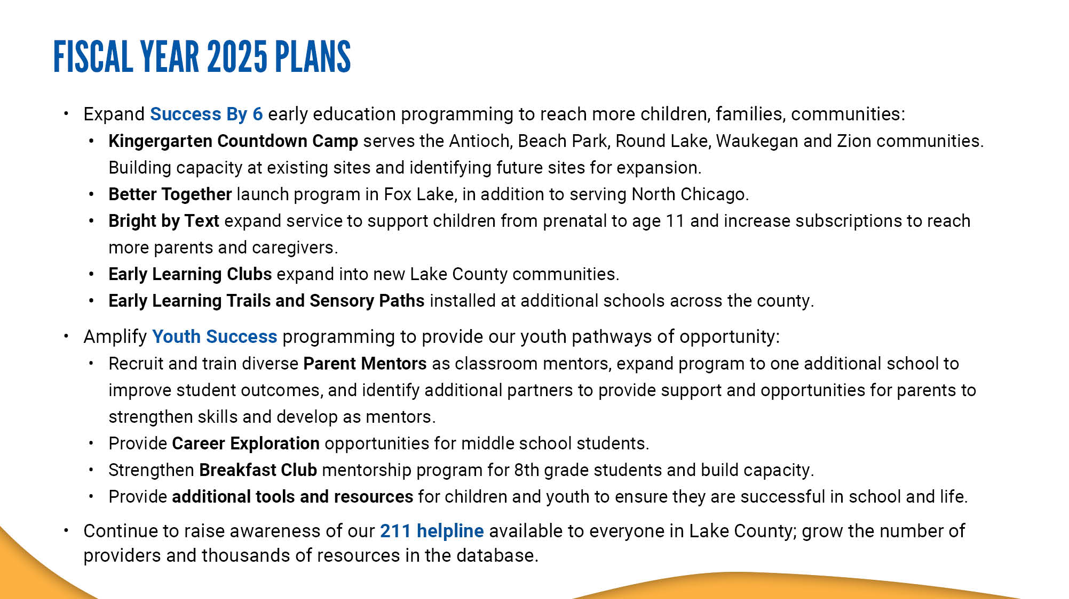
Notes:
Our plans for fiscal year 2025 include:
Expanding Success By 6 early education programming to reach more children and families, and additional communities:
Kindergarten Countdown Camp serves the Antioch, Beach Park, Round Lake, Waukegan and Zion communities. KCC is building capacity at existing sites and identifying future sites for expansion.
Better Together is launching in Fox Lake in fall 2024, in addition to serving existing site in North Chicago.
Bright by Text is expanding service to support children from prenatal to age 11 (previously the program supported children up to age 8), and increase subscriptions to reach more parents and caregivers.
Early Learning Clubs are expanding to new Lake County communities.
Early Learning Trails and Sensory Paths will be installed at additional schools across the county.
Amplifying Youth Success to provide our youth pathways of opportunity:
Recruiting and training new, diverse Parent Mentors as classroom mentors, expanding program to one additional school to improve student outcomes, and identifying additional partners to provide support and opportunities for parents to strengthen skills and develop as mentors.
Providing Career Exploration opportunities for middle school students.
Strengthening Breakfast Club mentorship program for 8th grade students and build capacity.
Providing additional tools and resources for children and youth to ensure success in school and life.
Continuing to raise awareness of our 211 helpline available to everyone in Lake County, as well as growing the number of service providers and thousands of resources in the database.

Slide 13
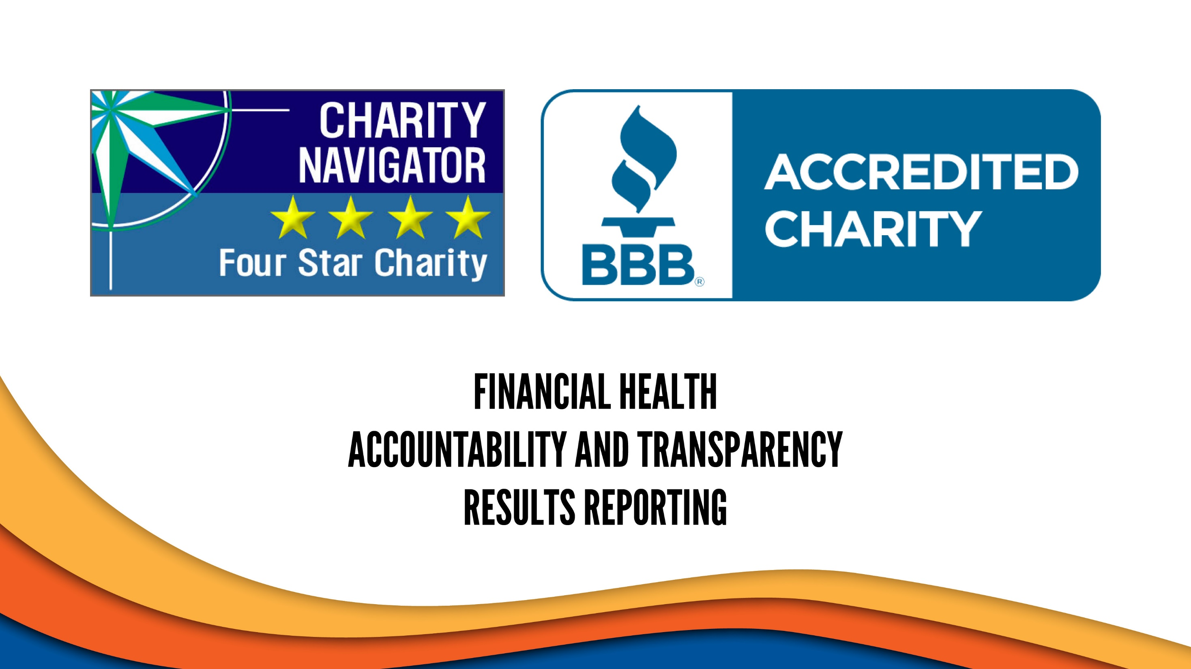
Notes:
We are proud to have earned Charity Navigator’s 4-star rating and are credited by the Better Business Bureau—both of which acknowledge our commitment to industry best practices.

Slide 14
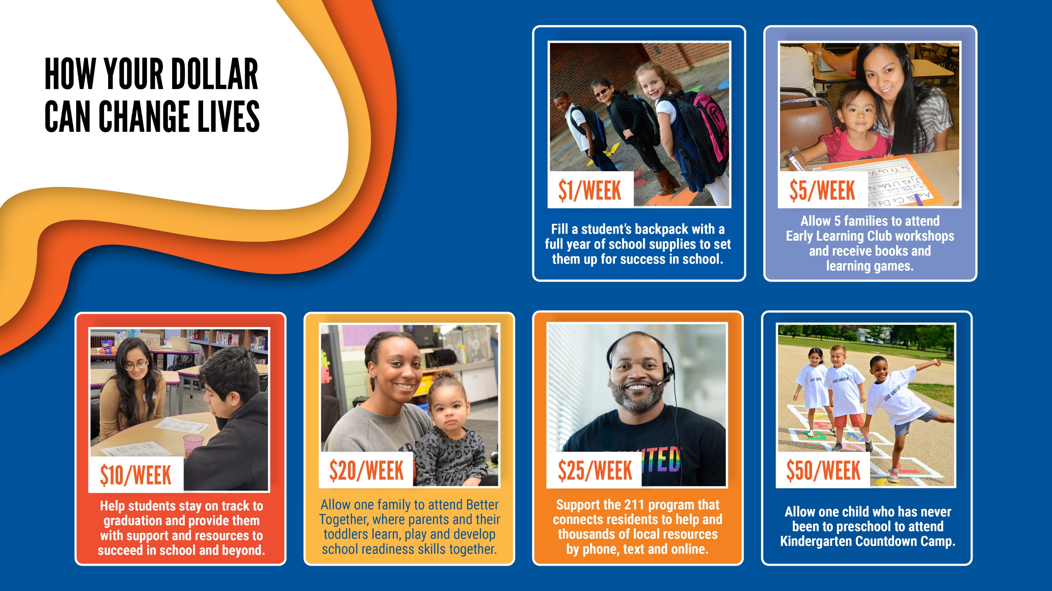
Notes:
Your support of United Way of Lake County helps change lives right here at home.
The money RAISED here, STAYS here.
Here's how your dollar can make a difference...

Slide 15
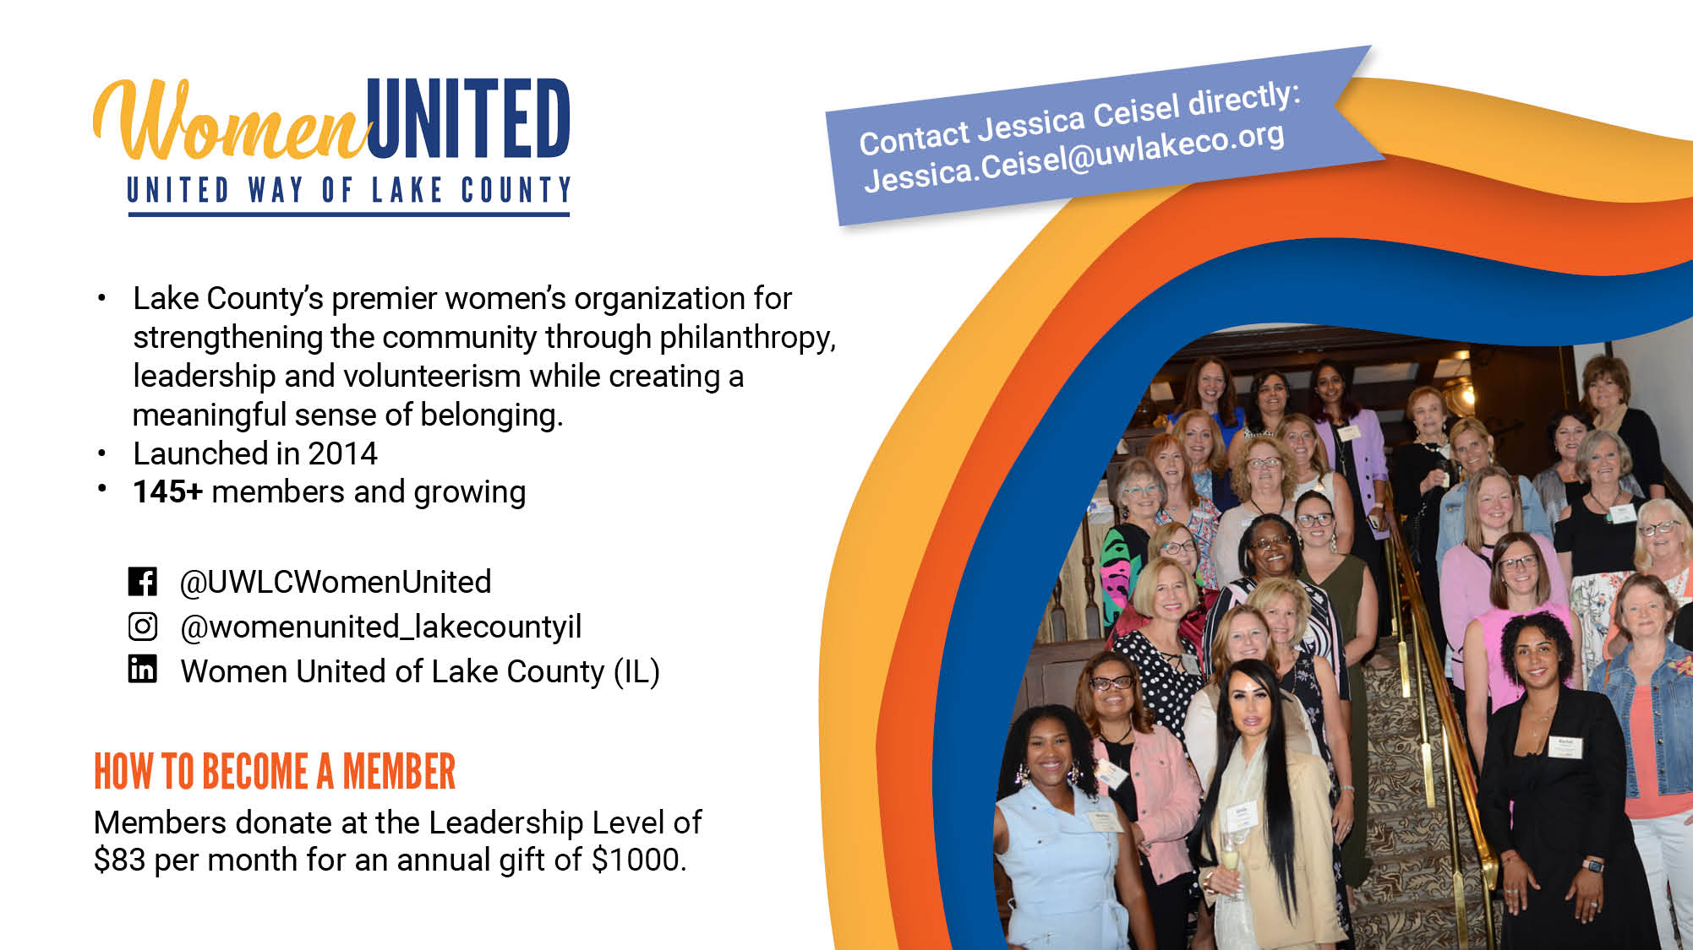
Notes:
Women United is a powerful network of more than 145 women who leverage their passions, ideas, expertise and resources to focus on their signature issue — early childhood education.
Since 2014, Women United has raised and granted more than $1.4 million for local early education programs through their Little Kids, Big Futures philanthropy fund.
They have a vibrant calendar of social, volunteer and philanthropic events to make it fun and doable regardless of busy schedules.
Members give at the Leadership Level with an annual gift of $1,000 or more.

Slide 16
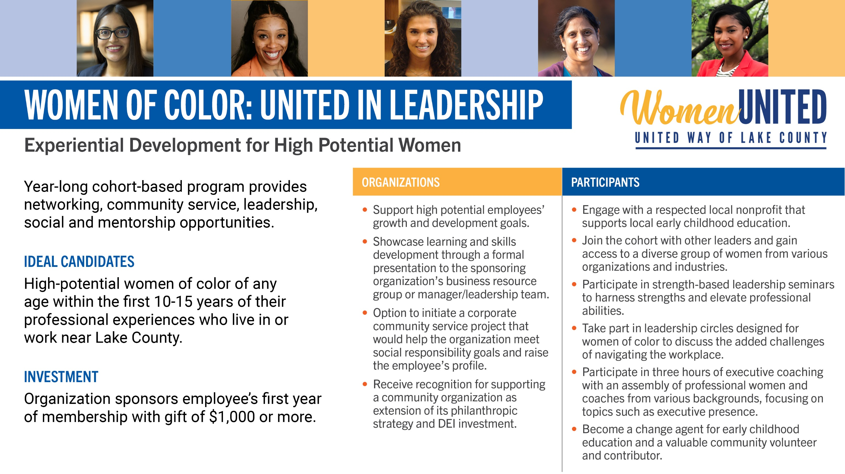
Notes:
Women of Color: United in Leadership is a project of Women United's Diversity, Inclusion & Belonging Initiative.
The year-long cohort-based program is a space for women of color who are growing in their leadership to explore their strengths together and build collective power both as professionals and community change agents.
Women of Color: United in Leadership provides networking, community service, leadership, social and mentorship opportunities by engaging and developing Lake County's women of color who demonstrate leadership potential.
Organizations sponsor their employee's first year of membership with a gift of $1,000 or more.

Slide 17
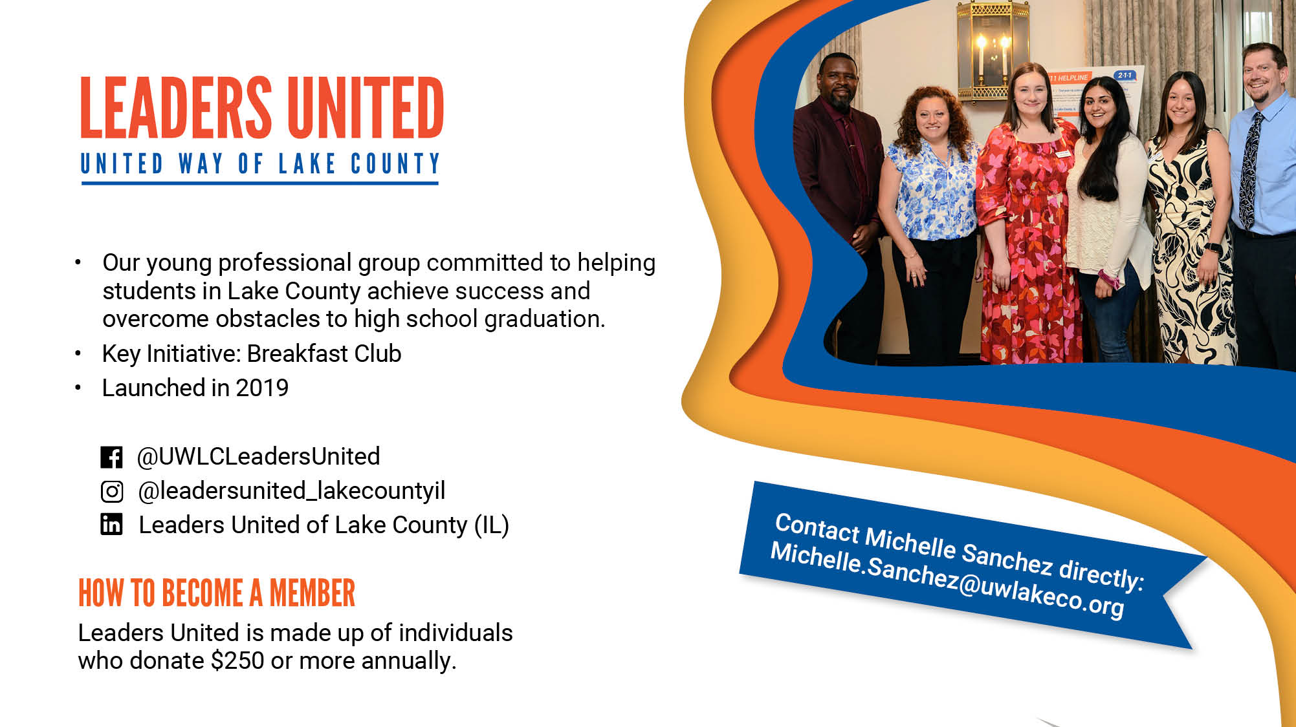
Notes:
Leaders United of Lake County is a group of young professionals committed to helping students succeed and overcome obstacles to high school graduation.
We believe that every student deserves the opportunity to reach their full potential, and we are working to make that a reality. By providing mentorship, tutoring, and other resources, we are helping students develop the skills and confidence they need to succeed. We are also working to remove the obstacles that stand in their way, such as poverty, lack of access to quality education, and discrimination. We believe that by working together, we can create a brighter future for all students in Lake County.
Leaders United's key initiative is Breakfast Club, a before-school mentorship program for middle schoolers. Mentors provide the students with academic support, important interactions to help build their confidence and self-esteem, and guidance on skills needed to be successful in high school and beyond.
Organizations can sponsor an employee's first year of membership with a gift of $250 or more.

Slide 18
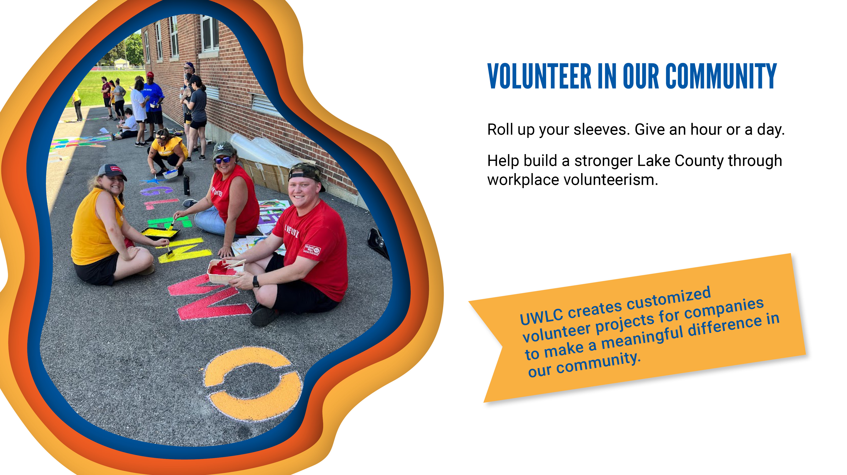
Notes:
We create customized experiences for companies of any size to make a meaningful difference in our community.
Employee engagement opportunities can help your company build stronger teams and boost employee morale and commitment.
Many companies have participated in creating Early Learning Trails and Sensory Paths at schools, book and school supply drives, gathering gifts for those in need during the holiday season, and more.
There are also remote/virtual opportunities to write notes of encouragement to seniors and veterans, create wellness kits and support diaper drives, etc.

Slide 19
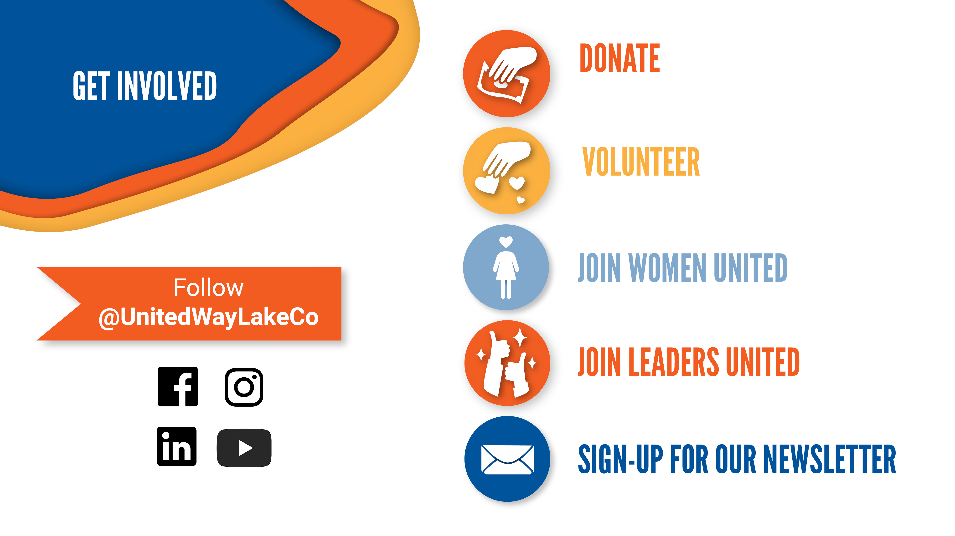
Notes:
There are many ways to get involved with United Way of Lake County.
Follow us on social.
Join one of our affinity groups.
Donate, volunteer and stay up-to-date on the latest news and events by signing up for our monthly newsletter.

Slide 20
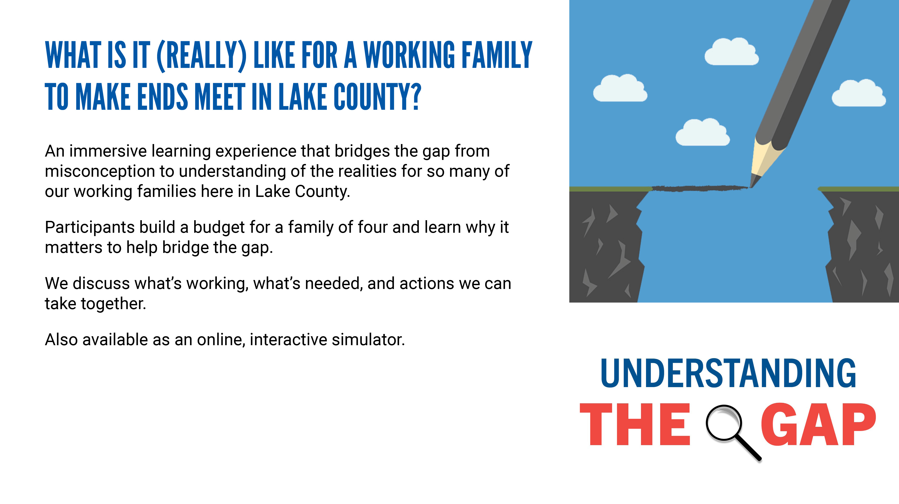
Notes:
Lastly, if you're interested, we offer a learning experience called Understanding the Gap which is designed to enhance awareness of the many challenges our working families face here in Lake County, the tough choices they need to make and how the work United Way of Lake County is doing is raising awareness of these important issues. These are working families who pay taxes with earnings above the Federal Poverty Level but who are struggling each month to make ends meet. It's a powerful tool to understand what it's like for many of our working families here in Lake County.
We offer a workshop for groups in person or virtually, as well as an online simulation for individual participation.

Slide 21
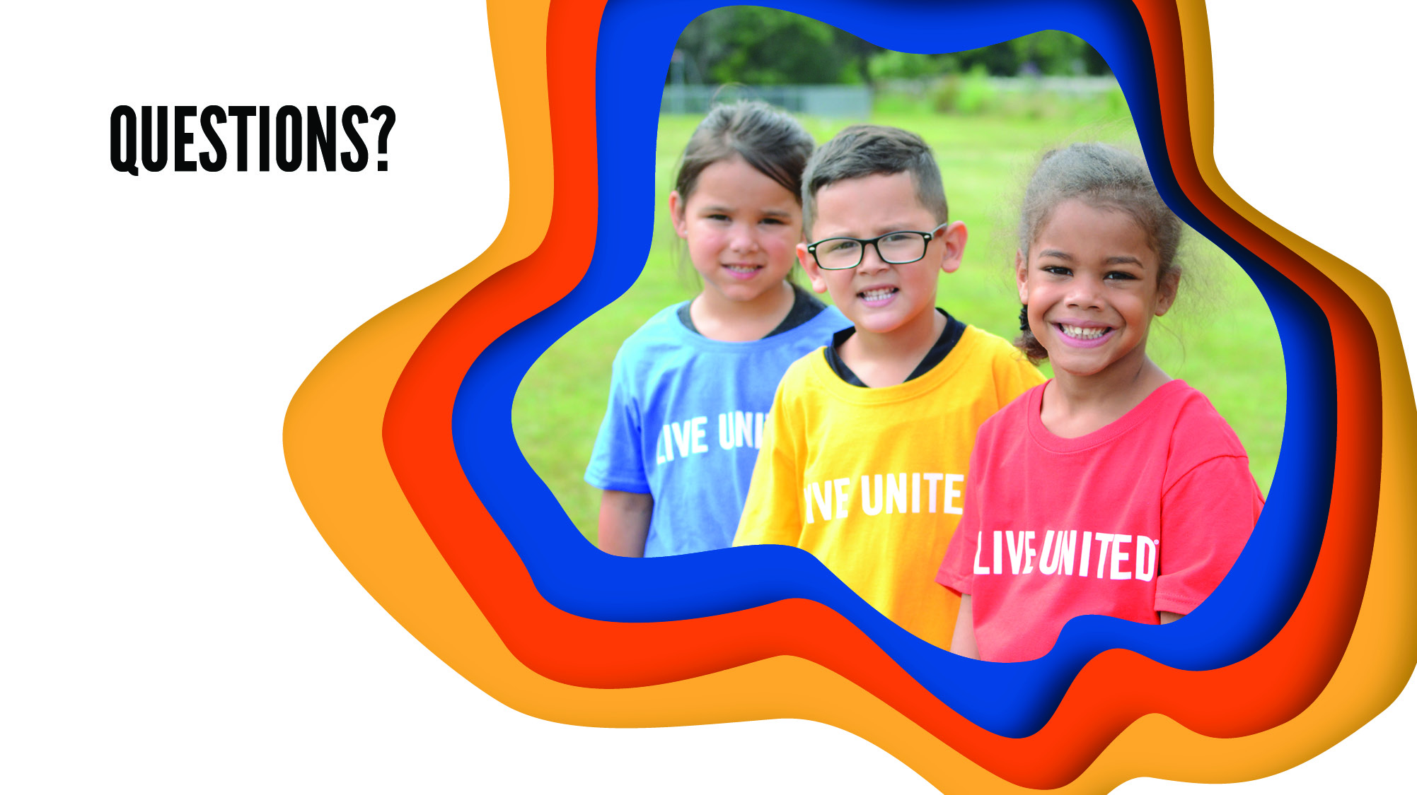
Notes:
What questions do you have?

